Slide 1

Setup of Postgres

Slide 2
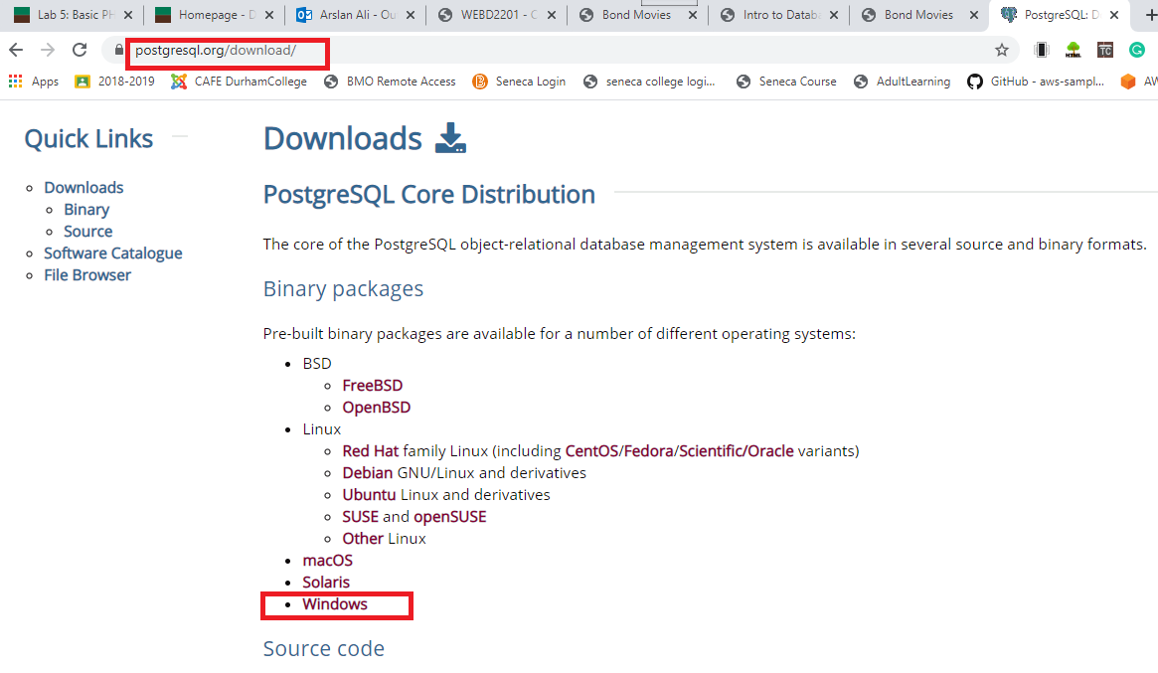
Step 1
Download

Slide 3
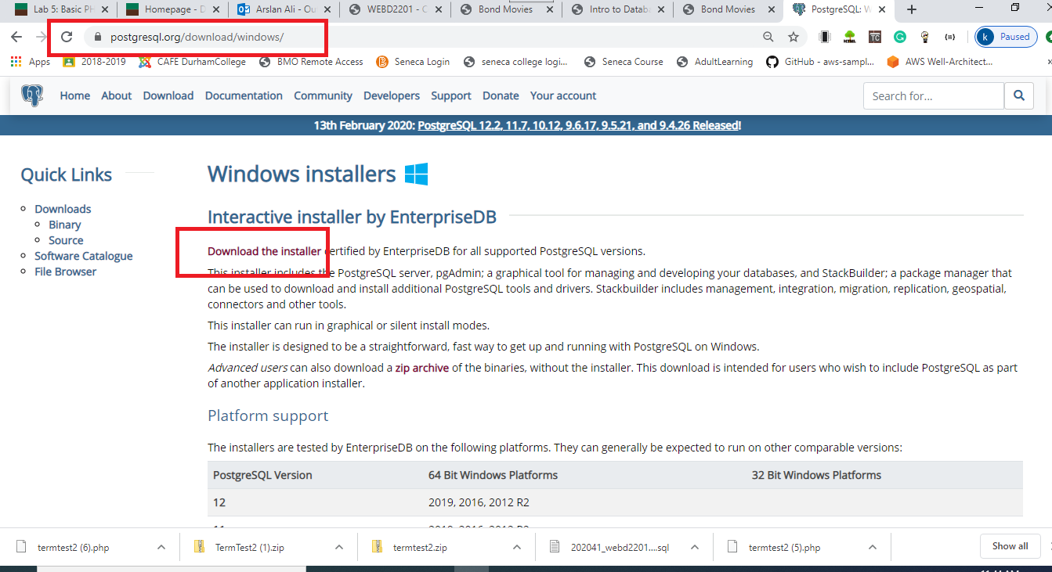
Step 2

Slide 4
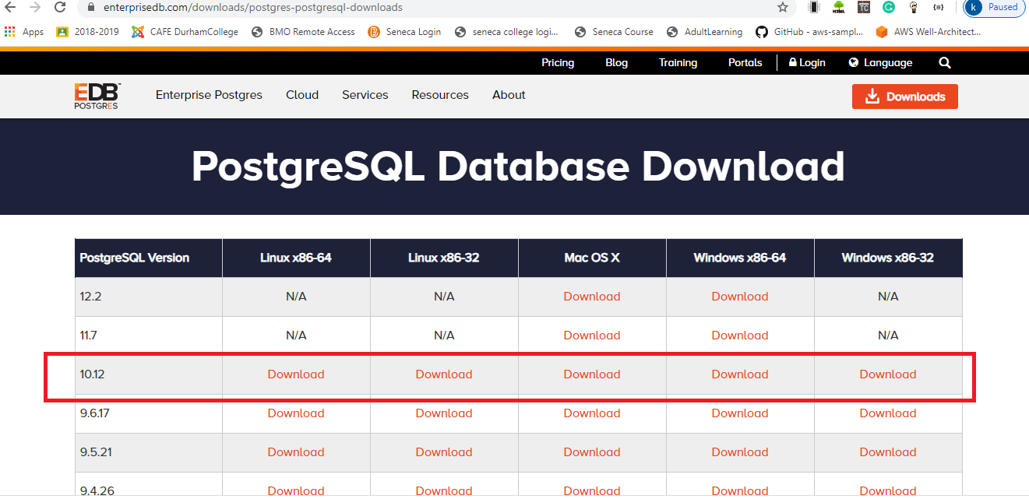
Step 3

Slide 5
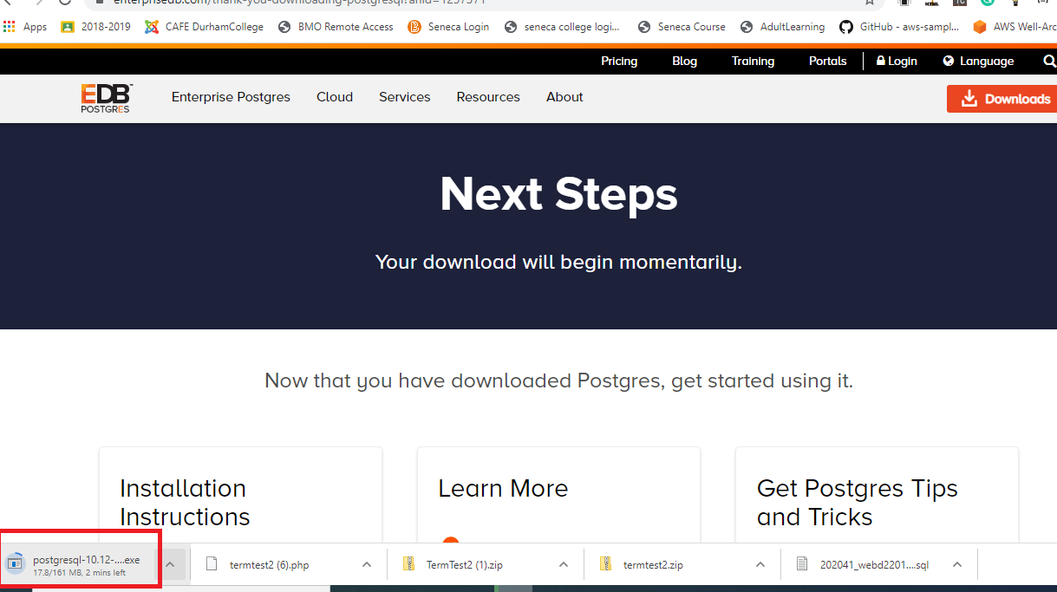
Step 4

Slide 6
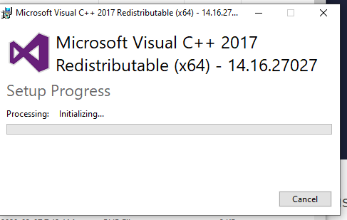
Step 5
You need Microsoft Visual C++

Slide 7
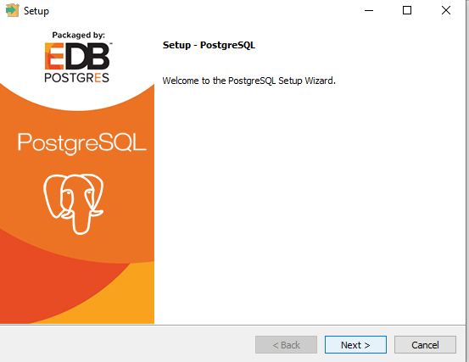
Step 6

Slide 8
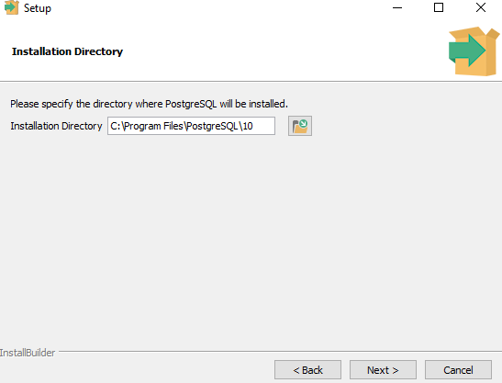
Step 7
define the path, keep it default

Slide 9
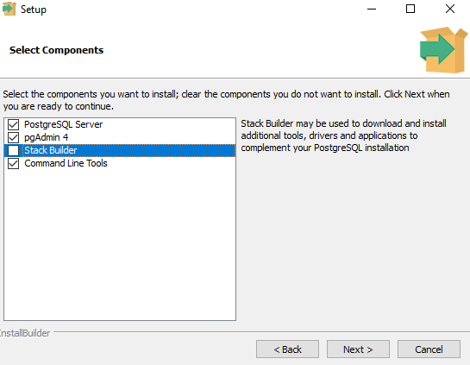
Step 8
Uncheck Stack Builder

Slide 10

Step 9
Keep the default location

Slide 11
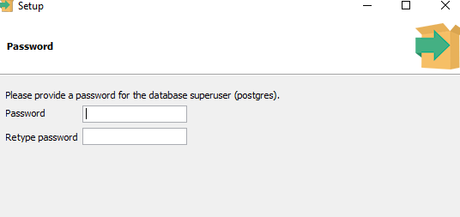
Step 10
Enter password: passw0rd
You have to remember this password for later
Note down at a safe location

Slide 12
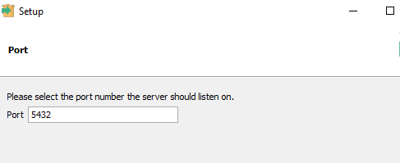
Step 11
Port 5432. keep this port

Slide 13
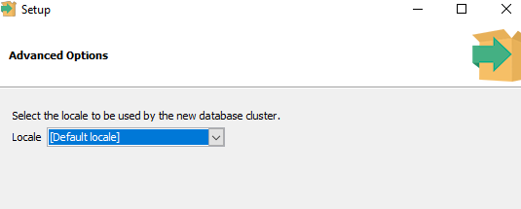
Step 12
Keep default

Slide 14
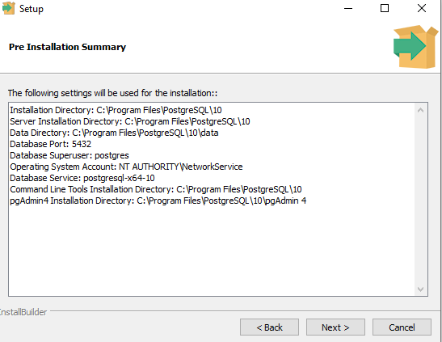
Step 13
Summary

Slide 15
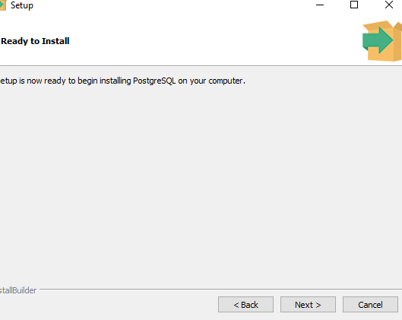
Step 14
Ready to install

Slide 16
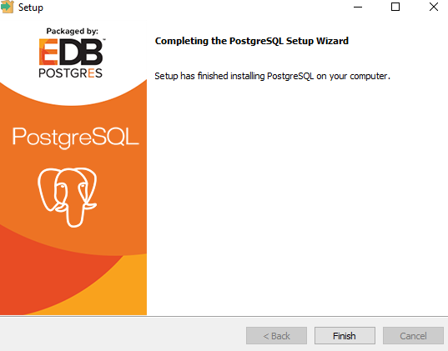
Step 15
Next

Slide 17
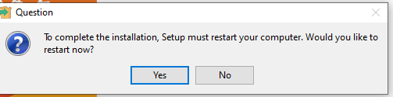
Step 16
Press Finish ... it may ask to restart

Slide 18
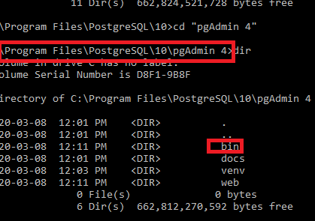
Step 17
Go to Program Files

Slide 19
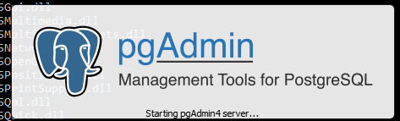
Step 18
Launch the pgAdmin

Slide 20
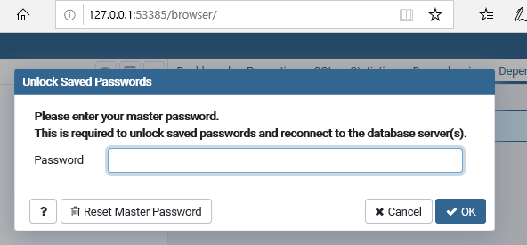
Step 19
Enter the password: passw0rd

Slide 21
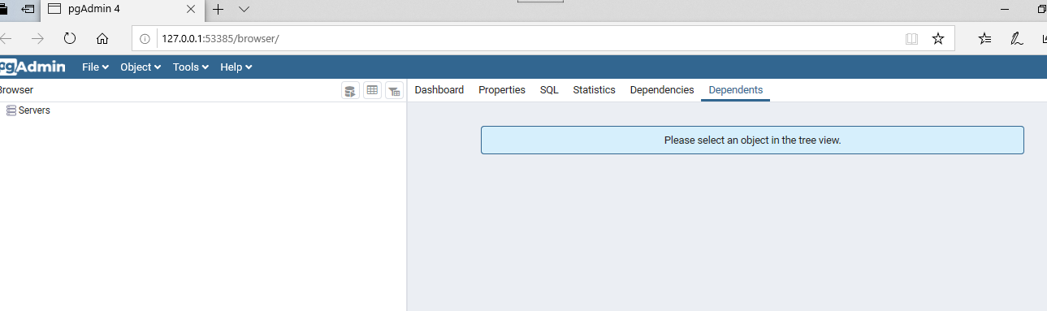
Step 20
Server

Slide 22
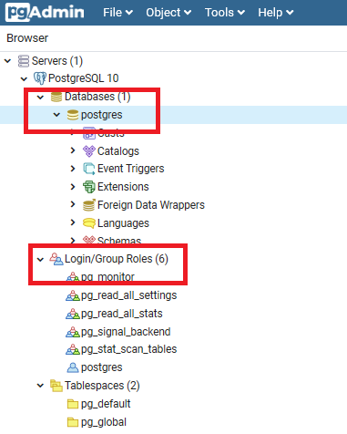
Step 21
Database and user by default

Slide 23
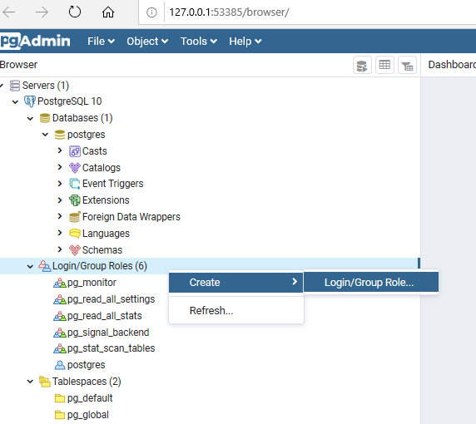
Create Login/Group Role
this is the user id that you use to sign into opentech server

Slide 24
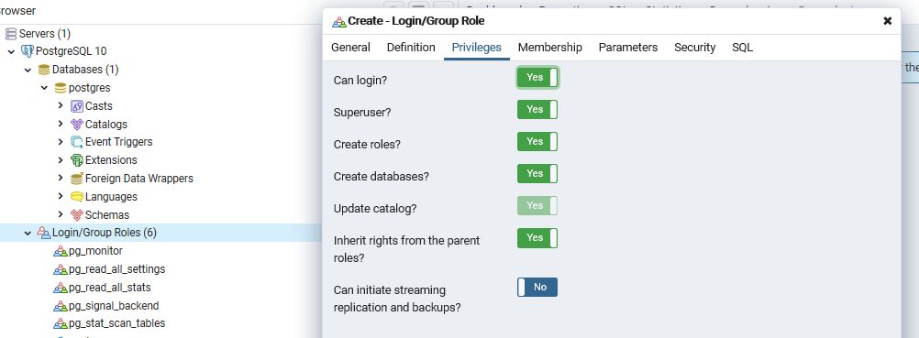
Give full Privileges

Slide 25
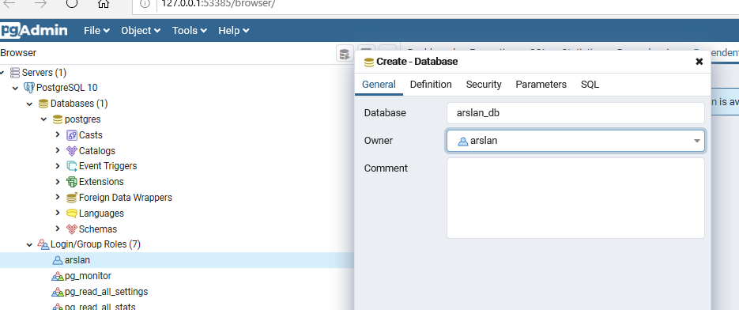
Create a new database
Create a new database userid_db and owner is arslan (in my case)

Slide 26
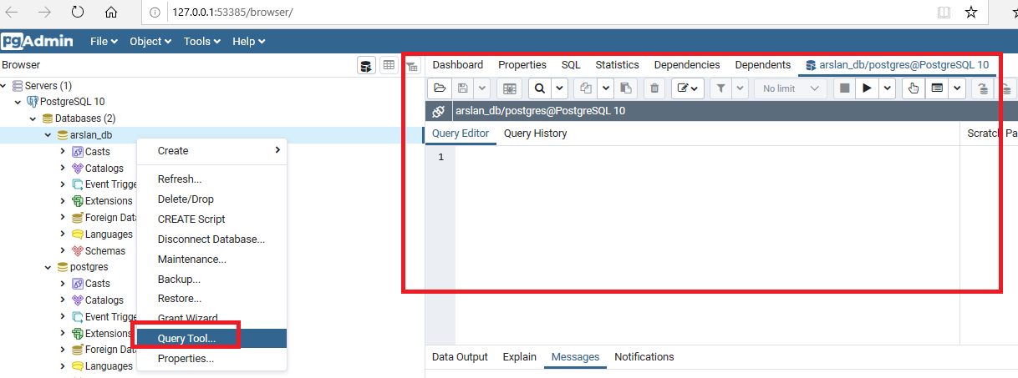
Query Tool
Launch the query tool

Slide 27
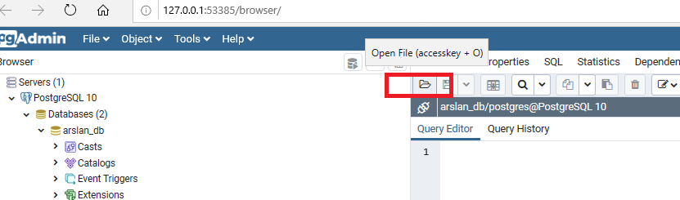
Load the sql file

Slide 28
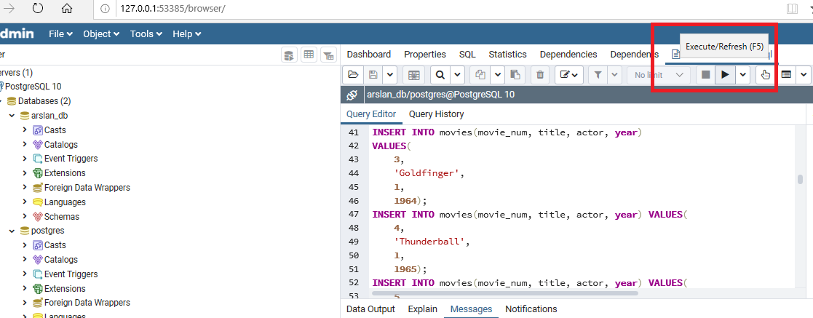
Execute the file

Slide 29
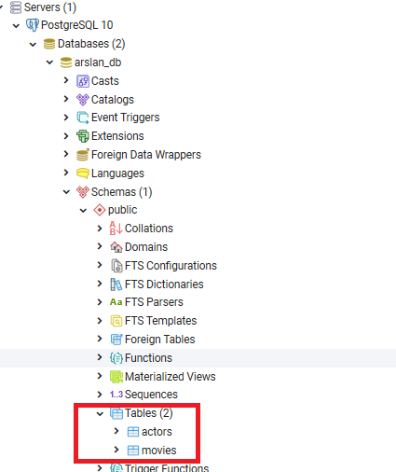
Confirm that files data is loaded

